Slide 1
Regional Sales Analysis
Exploratory Data Analysis

Slide 2
Problem Statement & objective
Current sales strategies lack data-driven alignment with revenue and profit drivers across regions, channels, and products, leading to suboptimal performance and high concentration risk.
Utilize EDA to identify core drivers, uncover trends/outliers, and measure performance to strategically optimize pricing, promotions, and expansion for sustained growth and reduced risk.

Slide 3
Approach
Exploratory Data Analysis (EDA): Clean, transform, and visualize sales and profit data.
Driver Identification: Use decomposition (e.g., Pareto analysis) to pinpoint the products, channels, and regions contributing most to revenue and profit.
Temporal Analysis: Apply time-series plots and decomposition to uncover seasonality, long-term trends, and sales outliers.
Strategic Recommendations: Translate findings into actionable recommendations for optimizing pricing, improving promotional effectiveness, and identifying low-risk expansion opportunities.

Slide 4
Data overview
Category | Key Metrics/Dimensions | Data Snapshot
Source & Scope | Source: | Corporate Sales & Budget Datasets
 | Sales Time Period: | 4 Years (January 1, 2014, to December 31, 2017)
 | Budget Scope: | 2017 Product Budgets only
Key Metrics | Total Revenue: | $1.24 Billion (approx.)
 | Total Gross Profit: | $461.8 Million (approx.)
 | Total Records: | 64,104 individual sales transactions
Grouping Variables | Products: | 30 unique products
 | Sales Channels: | 3 major channels (Wholesale, Distributor, Export)
 | Regions: | 993 unique delivery region indices (requires mapping/joining to Regions and State Regions tables)

Slide 5
Project Workflow
Data Consolidation & Preparation
Acquisition & Merge: Loaded all six CSV sheets and created a single master data table by joining them (Customers, Products, Regions, Budgets) to the Sales Orders base.
Cleansing & Scope: Filtered data to ensure a clean, four-year analysis period (2014–2017) and removed extraneous geographical and order-related columns.
Metric Generation & Dimensional Enrichment
Financial Metrics: Calculated the primary performance indicators: Profit (Revenue - Total Cost) and Total Cost Per Transaction.
Temporal Dimensions: Derived Year and segmented orders into four calendar Seasons (Winter, Spring, Summer, Autumn) from the OrderDate.

Slide 6
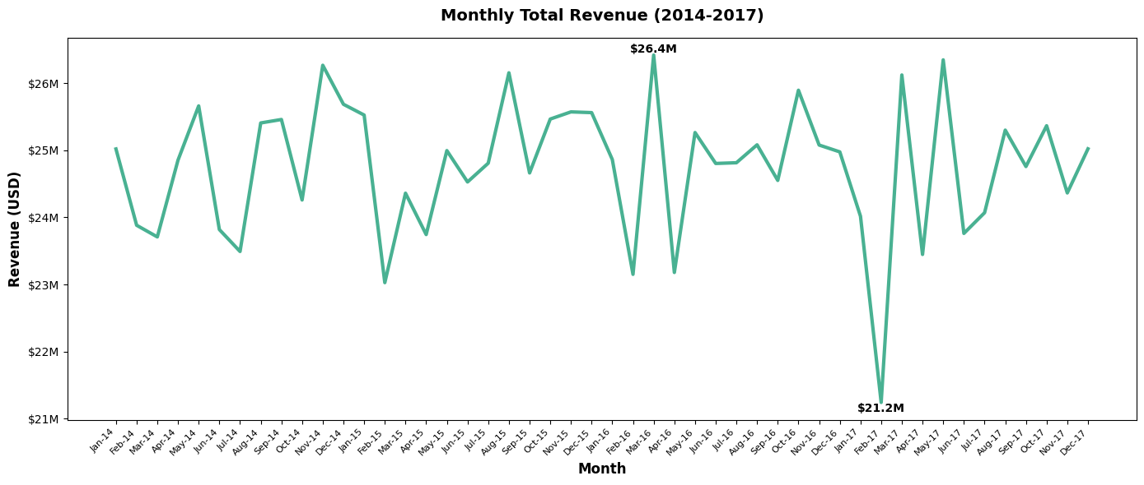
Exploratory Data Analysis (EDA)
Key Insight
Monthly Revenue Trend (2014–2017)
Annual Seasonality:
Revenue typically peaks in the Summer/Autumn months and drops slightly in Winter, suggesting a recurring seasonal sales cycle.

Slide 7
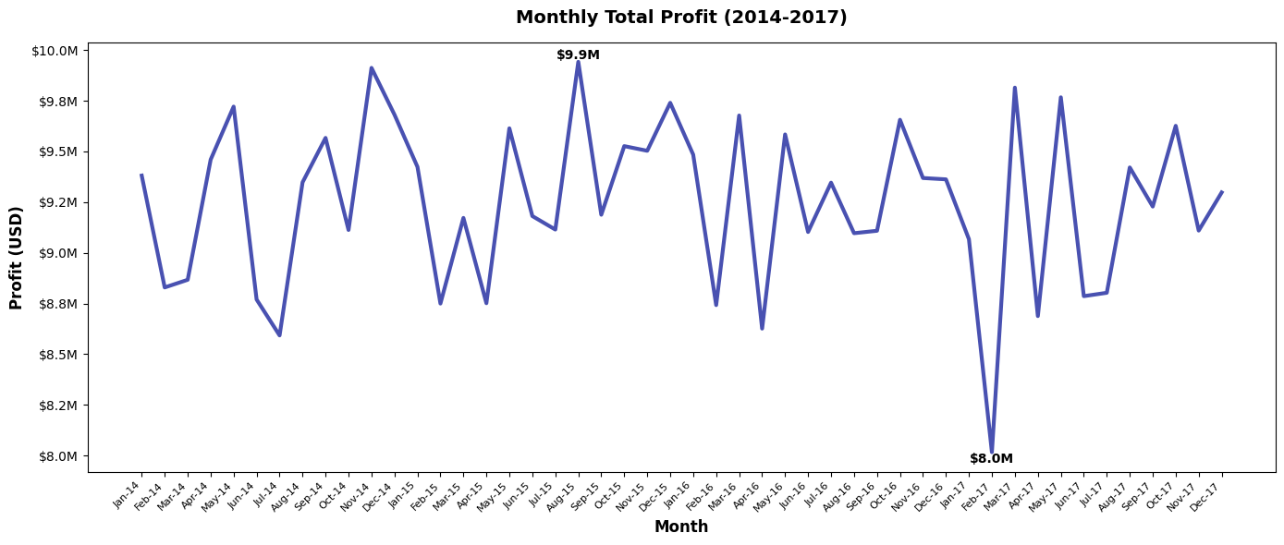
Exploratory Data Analysis (EDA)
Key Insight
Monthly Profit Trend (2014–2017)
Profit Mirrors Revenue:
The monthly profit curve closely follows the revenue curve, suggesting stable cost of goods sold relative to sales prices over the 4-year period.

Slide 8
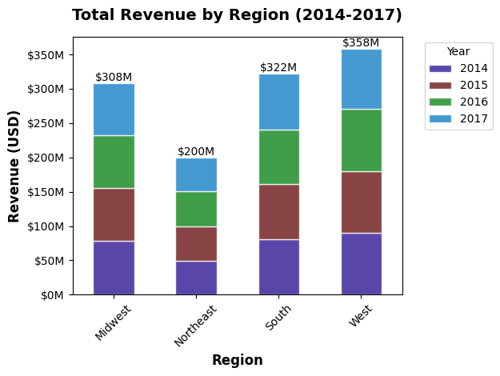
Exploratory Data Analysis (EDA)
Key Insight
Regional Revenue Performance (YOY)
West Dominance:
The West region is the unequivocal revenue leader, consistently contributing the largest total sales volume across all four years.

Slide 9
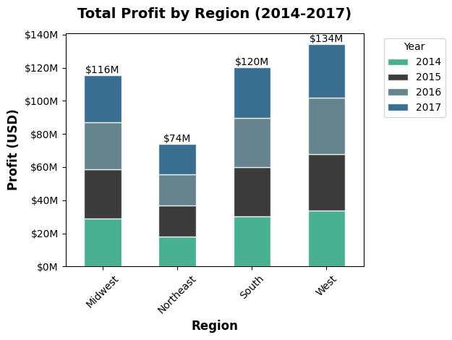
Exploratory Data Analysis (EDA)
Key Insight
Regional Profit Performance (YOY)
Margin Consistency:
Comparison with the Revenue chart shows all regions maintain similar profit margins over time, with no single region demonstrating unusually low or high profitability.

Slide 10
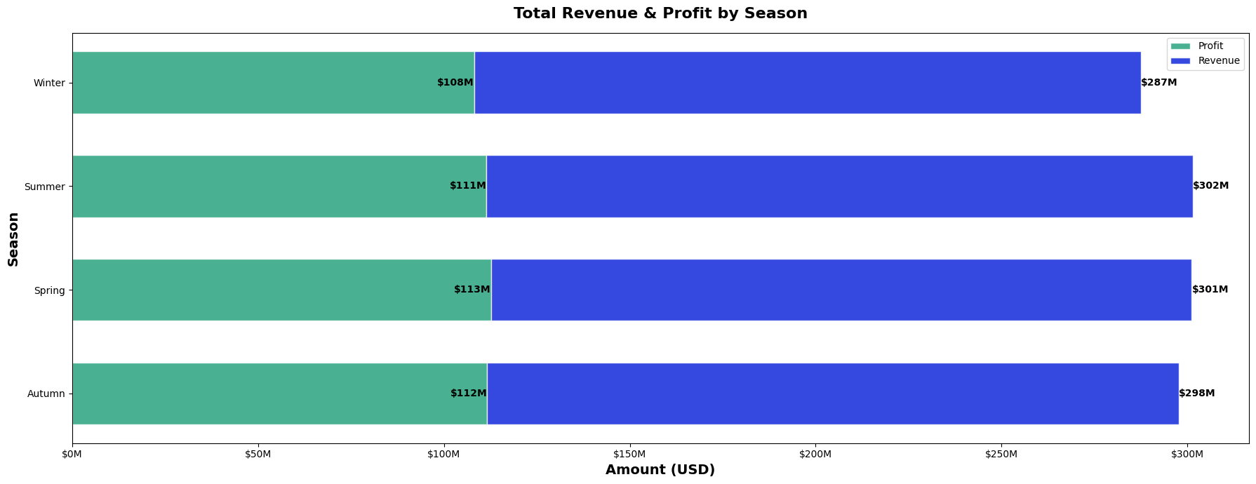
Exploratory Data Analysis (EDA)
Key Insight
Seasonal Financial Summary
Lowest Performance:
Winter consistently performs the lowest in both total Revenue and total Profit, confirming the annual seasonal slowdown identified in the monthly analysis.

Slide 11
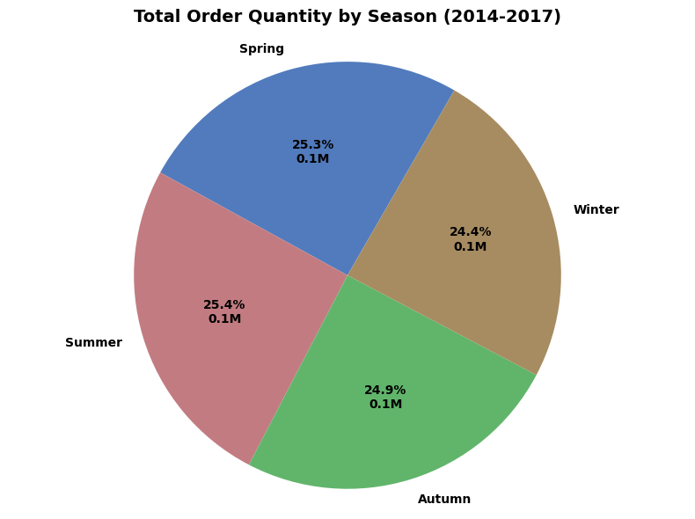
Exploratory Data Analysis (EDA)
Key Insight
Order Quantity by Season
Volume vs. Value:
The difference between this chart and the Seasonal Financial Summary chart suggests that higher-value items are more frequently sold in Spring/Autumn, while lower-value items may compensate in volume during other seasons.

Slide 12
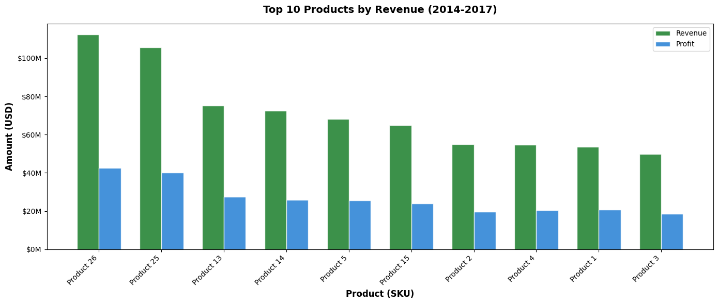
Exploratory Data Analysis (EDA)
Key Insight
Top 10 Products: Revenue vs. Profit
Product Purity:
Most top-revenue products are also top-profit products, signifying strong gross margins across the high-volume SKU mix.

Slide 13
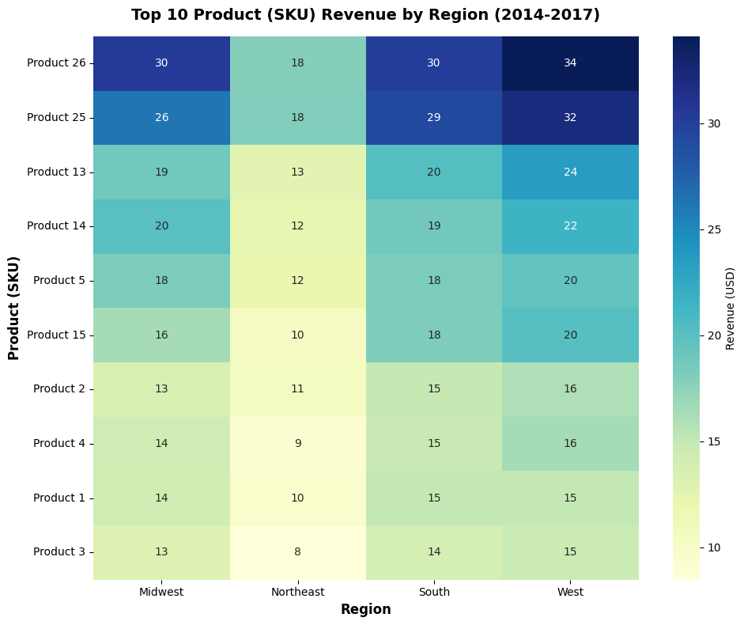
Exploratory Data Analysis (EDA)
Key Insight
Top 10 Product Revenues by Region
West & South Concentration:
Product sales are heavily concentrated in the two largest regions, West and South.

Slide 14
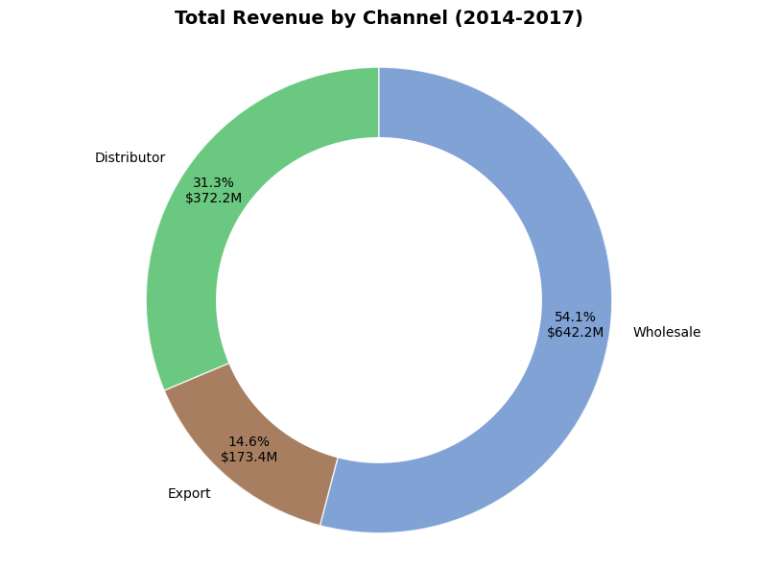
Exploratory Data Analysis (EDA)
Key Insight
Total Revenue by Channel
Dominant Channel:
Identified Wholesale as the single channel that delivers the largest percentage of total sales revenue.

Slide 15
Recommendations
Expand Geographically: The West and South regions dominate revenue and profit. Target the Midwest and Northeast for market expansion using the Top 10 SKUs to diversify risk and capture untapped potential.
Mitigate Winter Slump: Implement a focused Q1 Revenue Protection Strategy (e.g., promotional bundles or incentives) to offset the recurring financial and volume drop seen during the Winter season.
Prioritize Top-Tier SKUs: Dedicate the majority of inventory, production, and marketing spend to the Top 10 Products. Their performance drives a disproportionate share of total profit and requires focused resource allocation.
Optimize Channel Margin: Review the cost-to-serve for the highest revenue-generating channels. Audit the largest channels to ensure their Profit Share is proportional to their Revenue Share, flagging any that operate with surprisingly low margins.

